Slide 1
Dimensionality Reduction for Spatial-Temporally Distributed Data
Presented by Yueyu Hu, Zibo Ye

Slide 2
Outline
Background
Selection: Action Synopsis
Manipulation: Motion Synthesis and Editing
Conclusion

Slide 3
Background

Slide 4
Why?
To remove some parts of the data
Redundancy (We don’t need)
Irrelevance (We don’t care)
To get an abstract of the data
Saliency analysis
Efficient Manipulation

Slide 5
Where?
High-Dimension Spatial Representations
3D meshes
Point Cloud
Images (Light Field)
Temporal-Distributed Representations
Motion of Poses and Pixels
Animations

Slide 6
Selection: Action Synopsis
Assa J, Caspi Y, Cohen-Or D. Action synopsis: pose selection and illustration, ACM Transactions on Graphics (TOG). ACM, 2005, 24(3): 667-676.

Slide 7
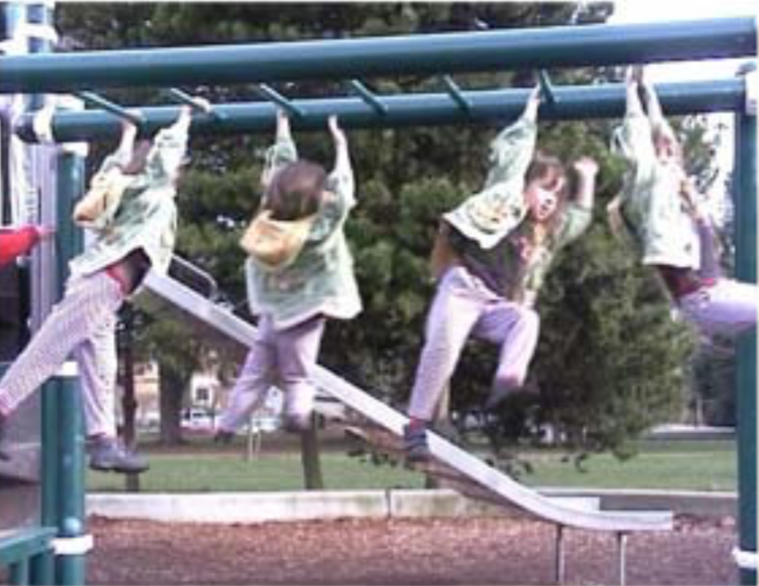
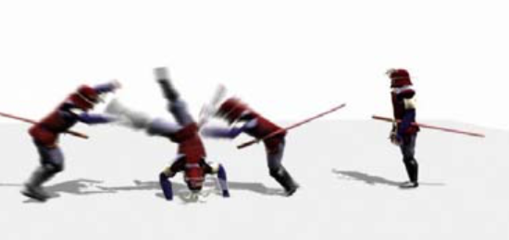
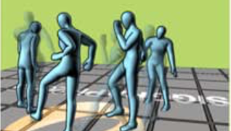
Synopsis: Motion in a Still Image
Story Summary
Action Recognition

Slide 8
Method
Extracts Aspects
Measuring Difference
Affinity matrix
Dimensionality Reduction
Replicated Multi-Dimensional Scaling (RMDS)
Pose Selection
Curve in the low dimensional space

Slide 9
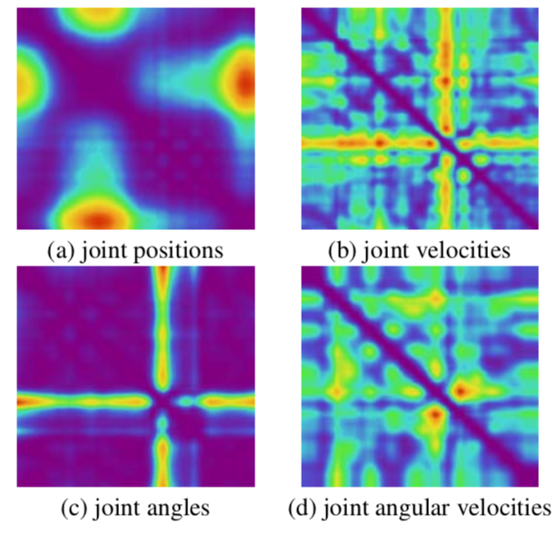
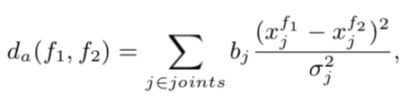
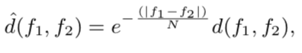
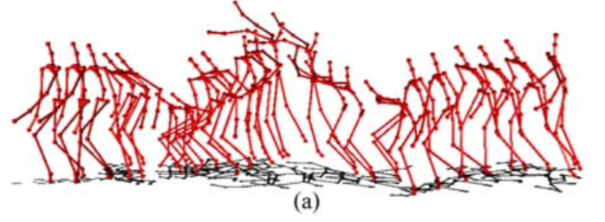
Affinity Matrices of Aspects
Position, Velocity, Angle & Angular Velocity
Affinity matrices to measure dynamics

Slide 10
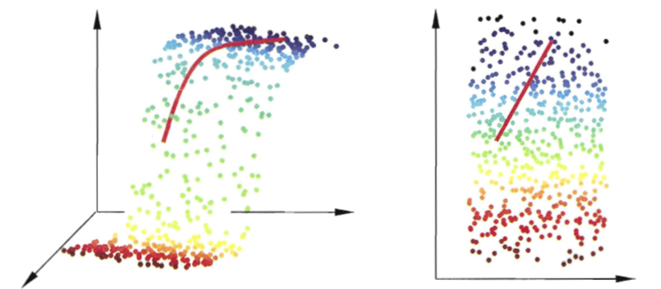
Multi-Dimensional Scaling (MDS)
Given Distances of Samples
Find Low Dimensional Representation
Preserve original distance

Slide 11
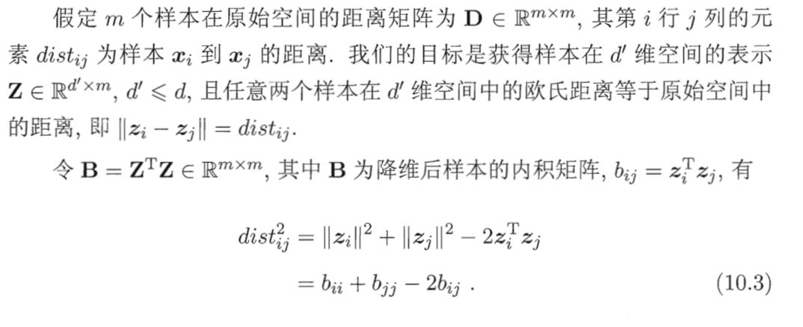
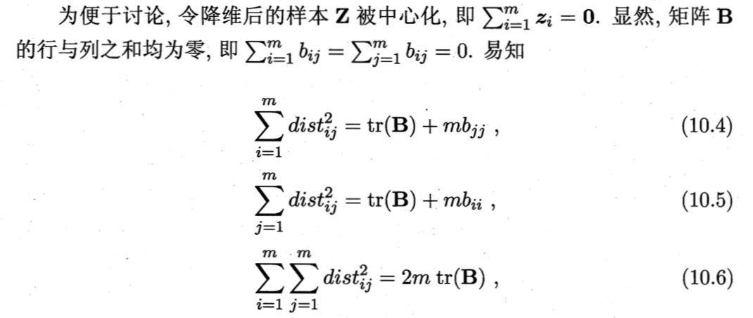
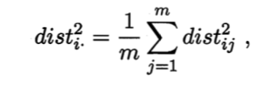
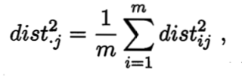
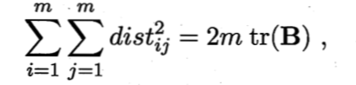
MDS

Slide 12
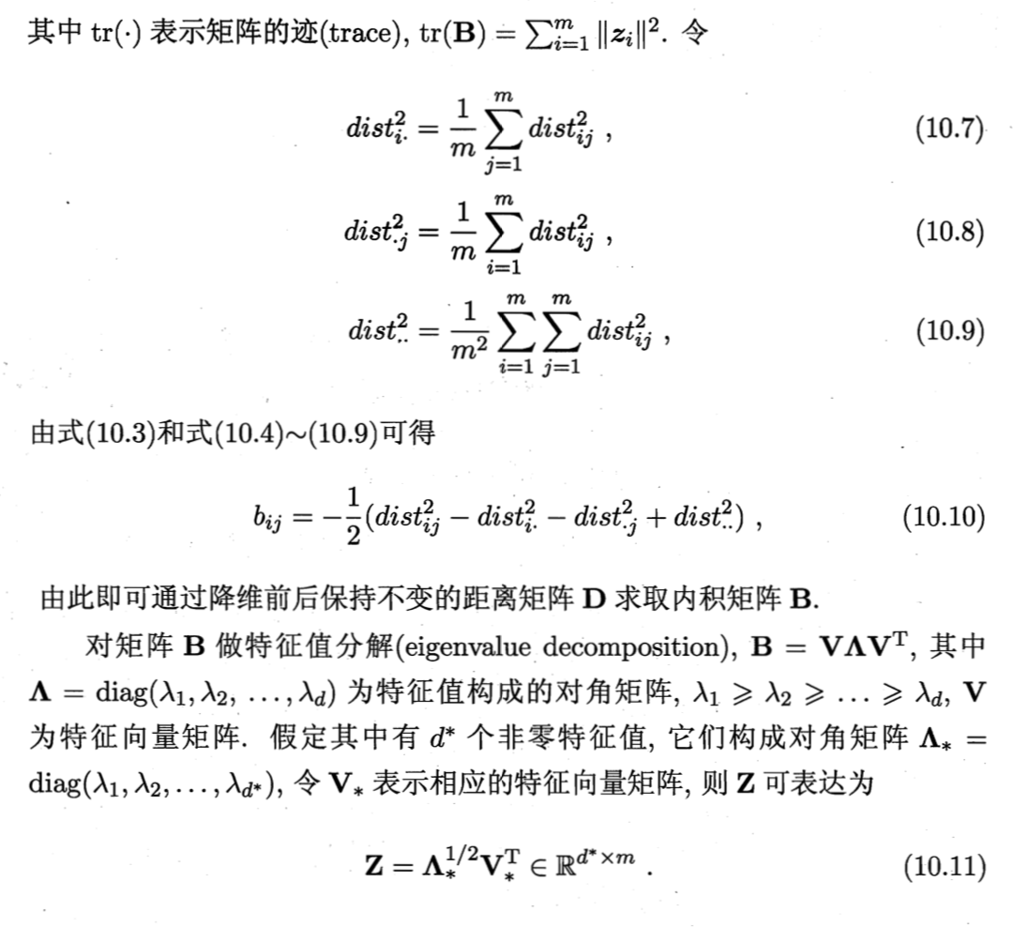
MDS

Slide 13
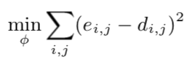
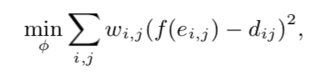
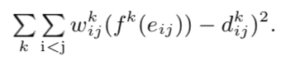
RMDS
Metric MDS
Non-Metric MDS
Keep Distance up to monotone increasing function
Replicated MDS
Analyze multiple affinity matrices

Slide 14
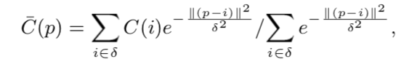
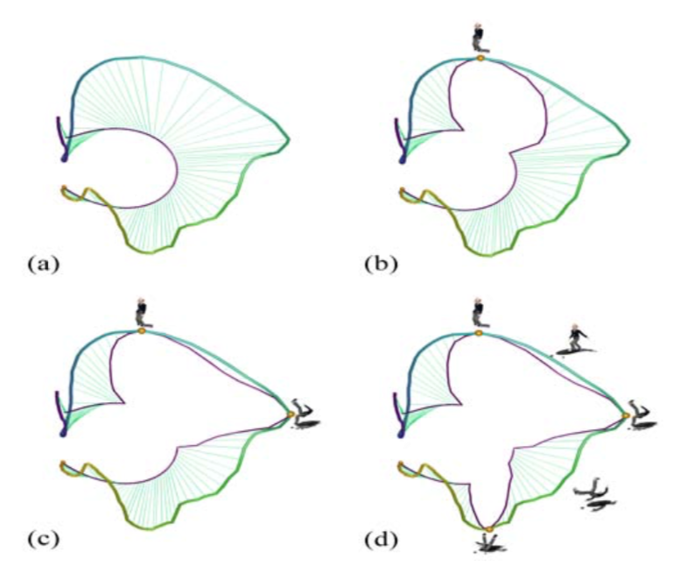
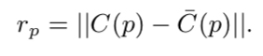
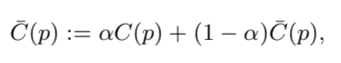
Pose Selection
Low-Dimensional Representation
Motion Curve in low-dim space
Smoothing / Averaging
Distance to Average
Iterative Selection

Slide 15
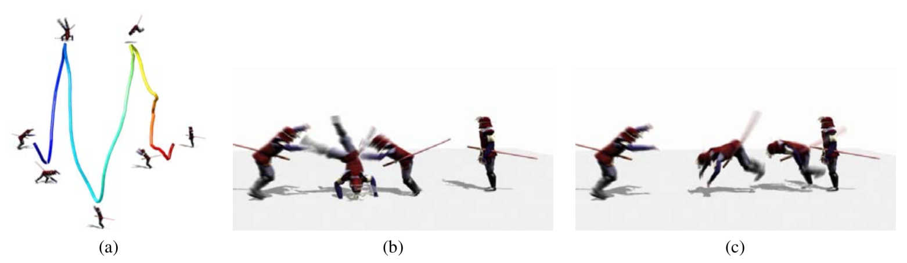
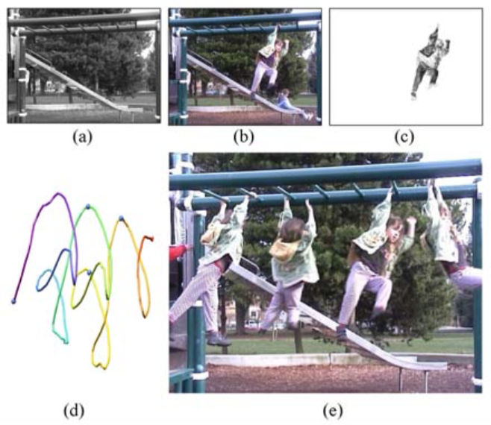
Experimental Results

Slide 16
Limitations
Arbitrary Aspects
Neglecting co-occurrence features
Only Bottom-Up Summarizing
No direct representation of motion
General Method for Dimensionality Reduction

Slide 17
Manipulation: Motion Synthesis and Editing
Levine S, Wang J M, Haraux A, et al. Continuous character control with low-dimensional embeddings. ACM Transactions on Graphics (TOG), 2012, 31(4): 28.

Slide 18
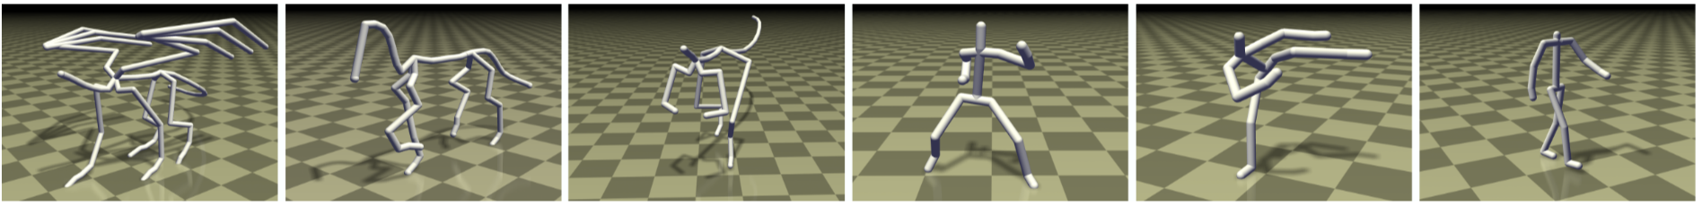
Continuous Pose Control
Representations of Pose Sequences
Manipulatable Embedding

Slide 19
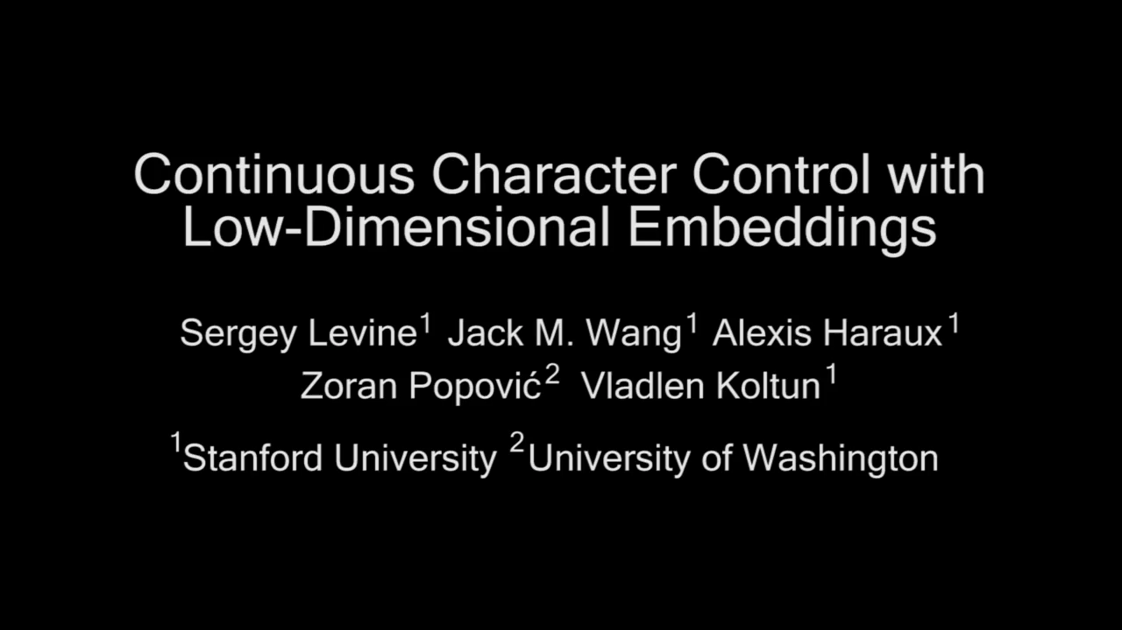
Visualization

Slide 20
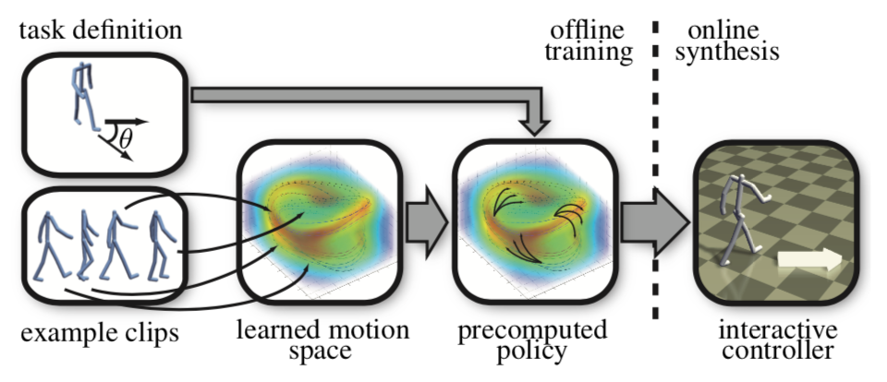
Method
Project Example Clips to Latent Space
Gaussian Process Latent Variable Model (GPLVM)
Connectivity prior
Pose Synthesis
Controlling

Slide 21
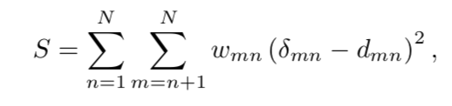
GPLVM Preliminaries
Distance Preserving Dim-Reduction (MDS)
Problems
Back-Projection to High Dimensional Space?
Missing Attributes?
Non-Linearity?
PCA / Kernel PCA

Slide 22
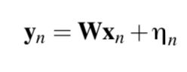
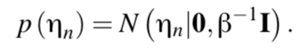
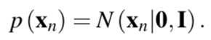
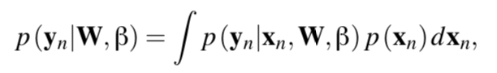
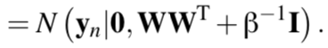
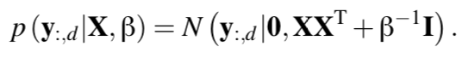
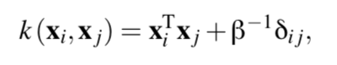
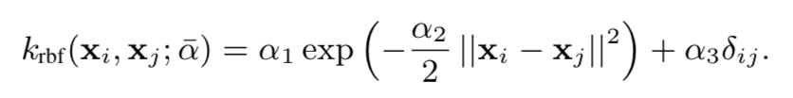
GPLVM
Problem:
Idea of Probability PCA:
Why W?
Non-Linear Modification

Slide 23
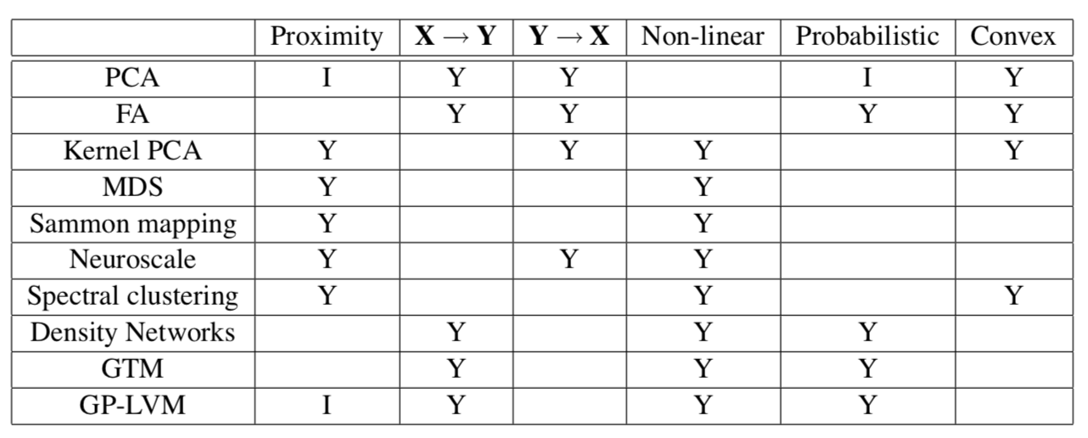
GPLVM
Comparison

Slide 24
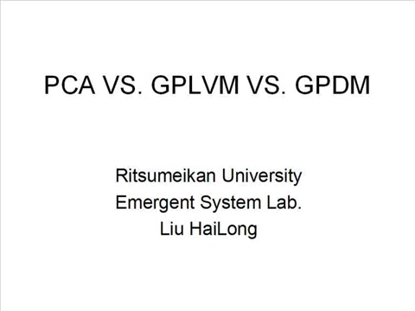
Comparison

Slide 25
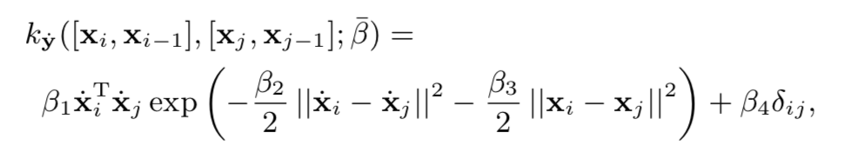
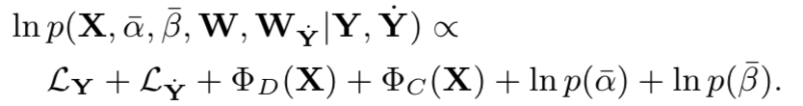
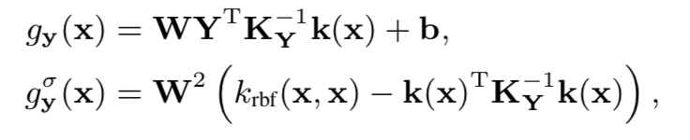
GPLVM misc.
Control of Velocity
Model Learning
Pose Synthesis

Slide 26
Conclusion

Slide 27
Dimensionality Reduction
An Open Problem
General? Specific?
The world might be simple
Or the principle component might be simple
Looking for a compact representation
Human?
Computer?

Slide 28
Thanks

